Slide 1

Randomized Quick Sort: A Complete Analysis
CS648: Randomized Algorithms
Mini Project Presentation
Aatman Jain
Aravind Seshadri
Kapu Nirmal Joshua

Slide 2
Randomized Quick Sort – The Algorithm
Random Pivot Selection
Unsorted Array A
x
A_{<x}
A_{>x}

Slide 3
Randomized Quick Sort – The Pseudo Code
RandomizedQuickSort(A,l,r):
if l < r then
q ← RandomPartition(A, l, r)
RandomizedQuickSort(A, l, q - 1)
RandomizedQuickSort(A, q + 1, r)
end if

Slide 4
Randomized Quick Sort – The Pseudo Code
RandomPartition(A, l, r):
i ← Random Number in [l, r]
swap(A[i], A[r])
x ← A[r]
j ← l − 1
for k ← l to r − 1 do:
if A[k] < x:
j ← j + 1
swap(A[j], A[k])
end if
end for
swap(A[j + 1], A[r])
Recursively call partitions
Repeat
Repeat

Slide 5
Notation
Node 1
L₁ = n
Node 2
Node 3
L₂
L₃
L₄
L₅
L₆
L₇
Node 4
Node 5
Node 6
Node 7
M_{n}^{k} := max list length at depth k = max { L_{j} : j = 2^{k}, 2^{k}+1, 2^{k}+2 ... 2^{k+1} – 1 }

Slide 6
Notation
Node 1
L₁ = n
Node 2
Node 3
L₂
L₃
L₄
L₅
L₆
L₇
Node 4
Node 5
Node 6
Node 7
Q_{n} := No. Of comparisons made by Randomized Quick Sort on any A with |A| = n

Slide 7
Notation
Node 1
L₁ = n
Node 2
Node 3
L₂
L₃
L₄
L₅
L₆
L₇
Node 4
Node 5
Node 6
Node 7
q_{n} := E(Q_{n}) = Expected Number of comparisons on all possible arrays of size n

Slide 8
Notation
Node 1
L₁ = n
Node 2
Node 3
L₂
L₃
Gives us H⁽²⁾ !
L₄
L₅
L₆
L₇
Node 4
Node 5
Node 6
Node 7
H^{(k)} = history AT depth k = knowledge of pivots AT a fixed depth k

Slide 9
Notation
Node 1
L₁ = n
Node 2
Node 3
L₂
L₃
Gives us H⁽²⁾ !
L₄
L₅
L₆
L₇
Node 4
Node 5
Node 6
Node 7
H^{(k)} = history UPTO depth k = knowledge of pivots UPTO a fixed depth k

Slide 10

Theorem – Concentration of Quick Sort
Asymptotic Upper Bound (Lemma 2.8)
For any ε > 0 : $Pr\left(\left|\frac{Q_{n}}{q_{n}}−1\right|≥ε\right)≤n^{−2ε( ln\left(\ln\left(n\right)) +O(ln⁡(4)(n)\right)}$
Let us prove both these bounds using the papers’ lemmas!
Asymptotic Lower Bound (Lemma 2.9)
For any ε > 0 : $\operatorname{Pr}\left(\left|Q_{n}−q_{n}\right|≥ε q_{n}\right)≥exp⁡\{ −2ε\ln\left(n\right)\ln\left(2\right)\left(n\right)+O(\ln\left(3\right)\left(n\right)) \}$

Slide 11

Experimental Setup
Input Array: Permutation of {1,2….n}
Array Size: 500 to 5M
Trials: 5000
Deviation ε:
1 to 100%
Step Size
Pr(exceeding μ by ε)
500
for n <= 2*10⁶
2000
for n > 2*10⁶
$\frac{No of Times Comparisons Exceed μ By \text{ε}}{Total Trials}$

Slide 12
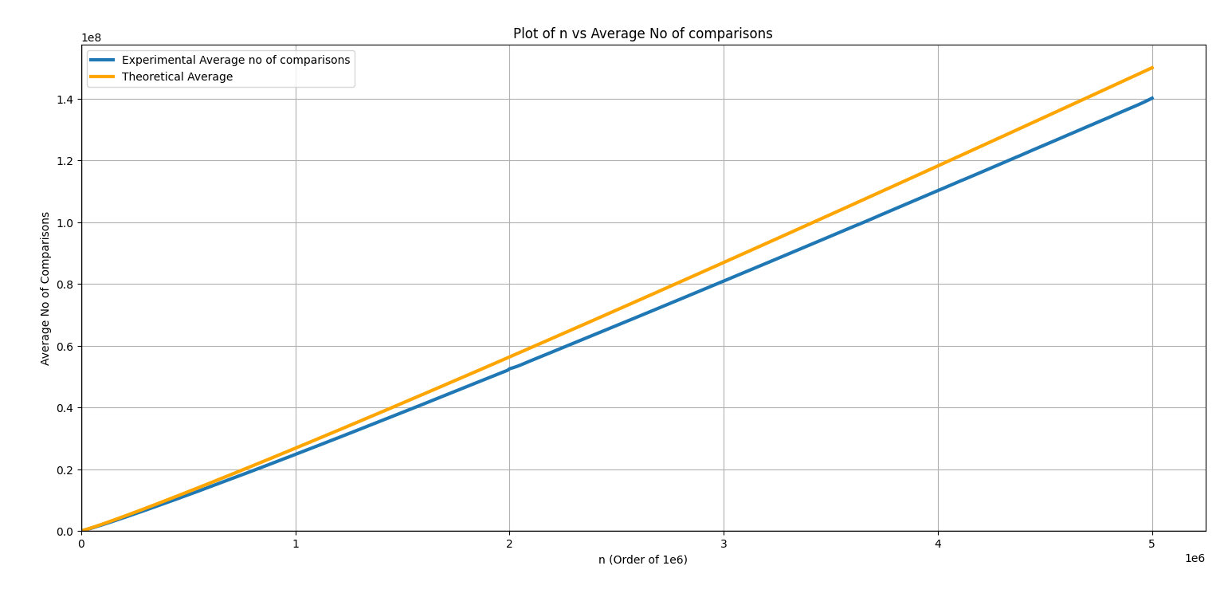

Slide 13
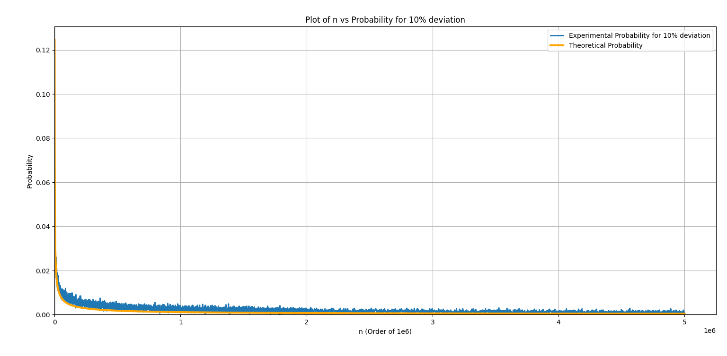

Slide 14
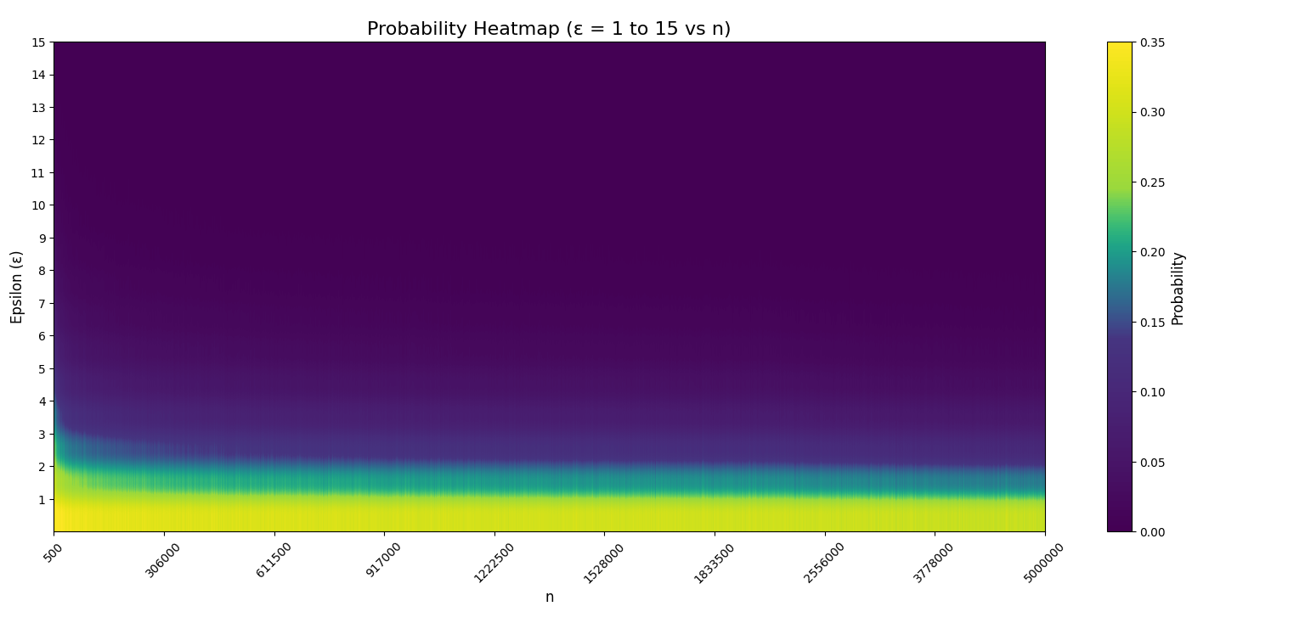

Slide 15
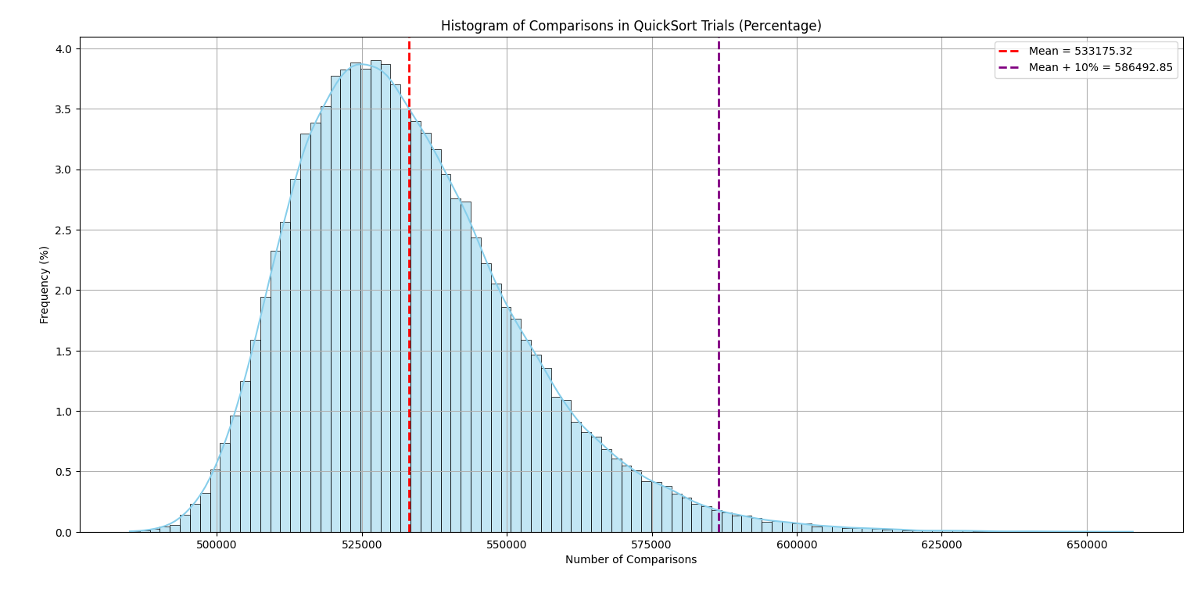

Slide 16


Lemma 2.1
Node 1
L₁ = n
Node 2
Node 3
L₂
L₃
Can we bound $M_{n}k$?
Recall that, M_{n}^{k} = max list length at depth k = max { L_{j} : j = 2^{k}, 2^{k}+1, 2^{k}+2 ... 2^{k+1} – 1 }
For a fixed real 0 < α < 1 and any integer k ≥ ln( 1 / α ):
$Pr( M_{n}k≥ \text{α}n \text{) }≤\text{α}$ $\left(\frac{2e\ln\left(\frac{1}{\text{α}}\right)}{k}\right)k$

Slide 17
Lemma 2.1 – Proof (Sketch)
Node 1
L₁ = n
X
1-X
Node 2
Node 3
L₂
L₃
We model $L_{2}=X ∗L_{1}$ and $L_{3}=\left(1−X\right)∗L_{1}$ where $X \sim U(0,1)$ → they have the same PDF!
In general, $L2i=Xi Li$ and $L2i+1=\left(1−Xi\right) Li$ where each $Xi \sim U(0,1)$ for $i≥1$
As $L_{i}≤n:$ $M_{n}k≥$ α$n$ $→\max{depth\left(j\right)=k}\left(X_{j}\right) ≥ \text{α}$
$Pr (M_{n}k≥$ α$n)$ $≤Pr ( max{depth\left(j\right)=k}\left(X_{j}\right) ≥ \text{α}$ $)$
$\max{depth\left(j\right)=k}\left(X_{j}\right) ≥ \text{α}$ → union over all $2^{k}$ possible paths ( $∏ᵢ Xi$ ) $≥$ $\text{α}$
Applying Union Bound, followed by Markov Inequality on the MGF, we get our result.

Slide 18


Lemma 2.6
Node i
Node j
k-1
L_{i}
L_{j}
$$H^{k}$$
k
L_{a}
L_{b}
L_{c}
L_{d}
Node a
Node b
Node c
Node d
Let $0<k_{1}<k_{2}$ and let $h(k_{1})$ be a $k_{1}$ history such that $M_{n}k≤ \text{α}n\text{.}$ Let A denote the
event that $H\left(k_{1}\right)$ ═ $h(k_{1)}$ then: $\operatorname{Pr}\left( \right|E\left(Q_{n}\right| \text{H}\text{(}\text{k}\text{2}\text{)})$ $−E\left(Q_{n} | A\right) \left| ≥s \right| A)≤2∗exp⁡(−\frac{s^{2}}{2\left(k_{2}−k_{1}\right)\text{α} n^{2}})$

Slide 19
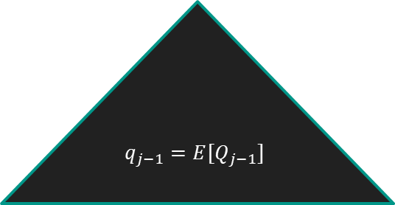

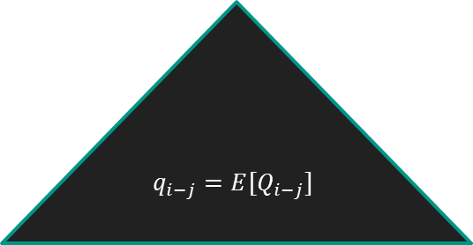
Lemma 2.6 – Proof (Sketch)
Pivot j is chosen
L_{i}
x
L_{k-1}
L_{i-k}
$$q_{j−1}=E[Q_{j−1}]$$
$$q_{i−j}=E[Q_{i−j}]$$
$X_{k}:=E[ Q_{n}| \text{H}\text{(}\text{k}\text{)}]$ where H^{(k)} is a r.v. of the history upto depth k with pivots chosen till k-1
$$T_{i}= L_{i} −1+q_{i−j}^{}+q_{j−1}^{}−q_{i}^{}$$

Slide 20


Lemma 2.6 – Proof (Sketch)
Pivot k is chosen
L_{i}
x
L_{k-1}
L_{i-k}
$$q_{k−1}=E[Q_{k−1}]$$
$$q_{i−k}=E[Q_{i−k}]$$
$$T_{i}= L_{i} −1+q_{i−k}^{}+q_{k−1}^{}−q_{i}^{}$$
$T_{i} is uniformly distributed in$
$$P=\{L_{i} −1+q_{i−j}^{}+q_{j−1}^{}−q_{i}^{} :j\}$$

Slide 21


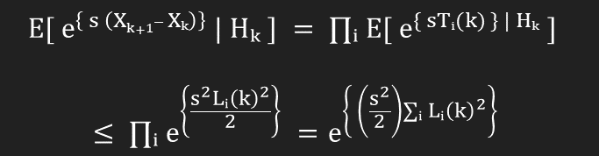
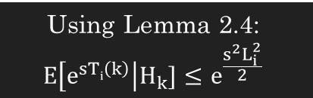

Lemma 2.6 – Proof (Sketch)
Let X be any random variable with a$≤$X$≤$b and E[X]=0 Then for every s≥0: E[$e^{sX}]≤$ $e^{s^{2}{\left(b−a\right)}^{2}/8}$
Lemma 2.4
Using Lemma 2.4:
$$E\left[e^{sTi\left(k\right)}\right|H_{k}]≤e^{\frac{s^{2}L_{i}^{2}}{2}}$$
We know that: E[$T_{i}\left(k\right)$]=0 and from Lemma 2.2: $−L_{i}\left(k\right)≤T_{i}\left(k\right)$ $≤$ $L_{i}\left(k\right)$
$$E[ e^{\left\{ s \left(Xk+1– Xₖ\right)\right\}} | Hₖ ] = ∏ᵢ E[ e^{\{ sTᵢ(k) \} | Hₖ} ]$$
$$≤ ∏ᵢ e^{\left\{\frac{s^{2}Lᵢ{\left(k\right)}^{2}}{2}\right\}} =e^{\left\{ \left(\frac{s^{2}}{2}\right)∑ᵢ Lᵢ{\left(k\right)}^{2}\right\}}$$
$$∑i Li\left(k\right)2 ≤ (maxi Li(k)) · (∑i Li(k)) ≤ αn·n = αn2$$

Slide 22
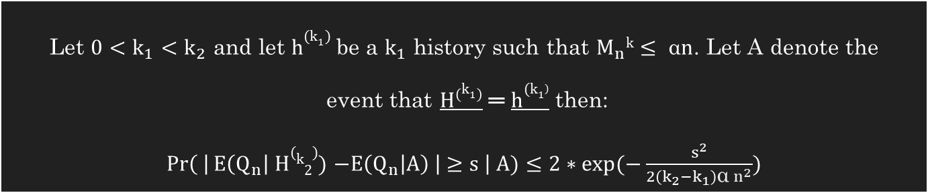

Lemma 2.6 – Proof (Sketch)
Comparing to Lemma 2.5 : $\text{c}\text{k}\text{2}\text{ = 4}αn2$ is our MOBD bound variable
Using this, we finally obtain lemma 2.6:
P[ 𝑋ₖ₂ − 𝑋ₖ₁ ≥ 𝑠 | 𝐴 ] ≤ 2$e^{\left\{\text{−2}\text{s}\text{²/(}\text{k}\text{₂ − }\text{k}\text{₁)·4}\text{α}\text{n}\text{²}\right\}}=\text{ 2}e^{\left\{\text{ −}\text{s}\text{²/(}\text{k}\text{₂ − }\text{k}\text{₁)·2}\text{α}\text{n}\text{²}\right\}}$
Let $0<k_{1}<k_{2}$ and let $h(k_{1})$ be a $k_{1}$ history such that $M_{n}k≤ \text{α}n\text{.}$ Let A denote the
event that $H\left(k_{1}\right)$ ═ $h(k_{1)}$ then: $\operatorname{Pr}\left( \right|E\left(Q_{n}\right| H(k2))$ $−E\left(Q_{n} | A\right) \left| ≥s \right| A)≤2∗exp⁡(−\frac{s^{2}}{2\left(k_{2}−k_{1}\right)\text{α} n^{2}})$

Slide 23

Lemma 2.7
Let n and s be positive integers. Then, for any real α with 0 < α ≤ 1 and any two positive integers $k_{1} and$k₂ satisfying: $k_{1}≥ln⁡(1/\text{α}\text{)}$ $k_{2}>k_{1}$ and $k_{2}>\ln\left(\frac{n}{2}\right)$ we have:
$$\operatorname{Pr}\left( \left|Q_{n}−q_{n}\right|≥k_{1}n+s \right) ≤ \frac{2}{n}∗\left(\frac{2e\ln\left(\frac{n}{2}\right)}{k_{2}}\right)k_{2}+{\text{α}\left(\frac{2eln\left(\frac{1}{\text{α}}\right)}{k1}\right)}^{k_{1}}+ 2 exp\left(−\frac{s^{2}}{2\left(k_{2}−k_{1}\right)\text{α} n^{2}}\right)$$
We shall use this lemma to prove our asymptotic upper bound, with appropriate substitution!

Slide 24


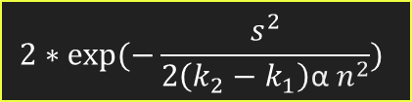

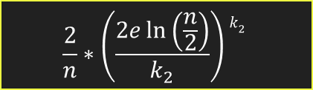
Lemma 2.7 – Proof (Sketch)
$$\operatorname{Pr}\left( \left|Q_{n}−q_{n}\right|≥k_{1}n+s \right)≤\frac{2}{n}∗\left(\frac{2e\ln\left(\frac{n}{2}\right)}{k_{2}}\right)k_{2}+{\text{α}\left(\frac{2eln\left(\frac{1}{\text{α}}\right)}{k1}\right)}^{k_{1}}+2∗exp⁡(−\frac{s^{2}}{2\left(k_{2}−k_{1}\right)\text{α} n^{2}})$$
$$R_{n}:=E\left(Q_{n}\right| H\left(k_{2}\right))$$
$$Pr⁡( \left|Q_{n}−q_{n}\right|≥k_{1}n+s )$$
Using Partition Theorem
$$\frac{2}{n}∗\left(\frac{2e\ln\left(\frac{n}{2}\right)}{k_{2}}\right)k_{2}$$
$$2∗exp⁡(−\frac{s^{2}}{2\left(k_{2}−k_{1}\right)\text{α} n^{2}})$$
$${\text{α}\left(\frac{2eln(\frac{1}{\text{α}})}{k1}\right)}^{k_{1}}$$
Lemma 2.6 Application
Lemma 2.1 Application
Lemma 2.1 Application

Slide 25








Deriving the Upper Bound
$$Pr⁡( \left|Q_{n}−q_{n}\right|≥k_{1}n+s )$$
$$\frac{2}{n}∗\left(\frac{2e\ln\left(\frac{n}{2}\right)}{k_{2}}\right)k_{2}$$
$$2∗exp⁡(−\frac{s^{2}}{2\left(k_{2}−k_{1}\right)\text{α} n^{2}})$$
$${\text{α}\left(\frac{2eln(\frac{1}{\text{α}})}{k1}\right)}^{k_{1}}$$
$$s=\frac{n\ln\left(n\right)}{\ln{\ln\left(n\right)}}$$
$$α={\left(\ln{\ln{n}}\right)}^{−5}$$
Substitute
$$k_{1}=2ε\ln{n}−\frac{2ε}{n}$$
$$k_{2}=\ln{n\ln{\ln{n}}}$$

Slide 26

Lemma 2.8 – The Upper Bound
$$Pr⁡( \left|Q_{n}−q_{n}\right|≥k_{1}n+s )$$
$$\frac{2}{n}∗\left(\frac{2e\ln\left(\frac{n}{2}\right)}{k_{2}}\right)k_{2}$$
$$2∗exp⁡(−\frac{s^{2}}{2\left(k_{2}−k_{1}\right)\text{α} n^{2}})$$
$${\text{α}\left(\frac{2eln(\frac{1}{\text{α}})}{k1}\right)}^{k_{1}}$$
$$For any ε>0, Pr\left(\left|\frac{Q_{n}}{q_{n}}−1\right|≥ε\right)≤n^{−2ε( ln\left(\ln\left(n\right)) +O(ln⁡(4)(n)\right)}$$

Slide 27
Thank You!
CS648: Randomized Algorithms
Aatman Jain
Aravind Seshadri
Kapu Nirmal Joshua

